Slide 1
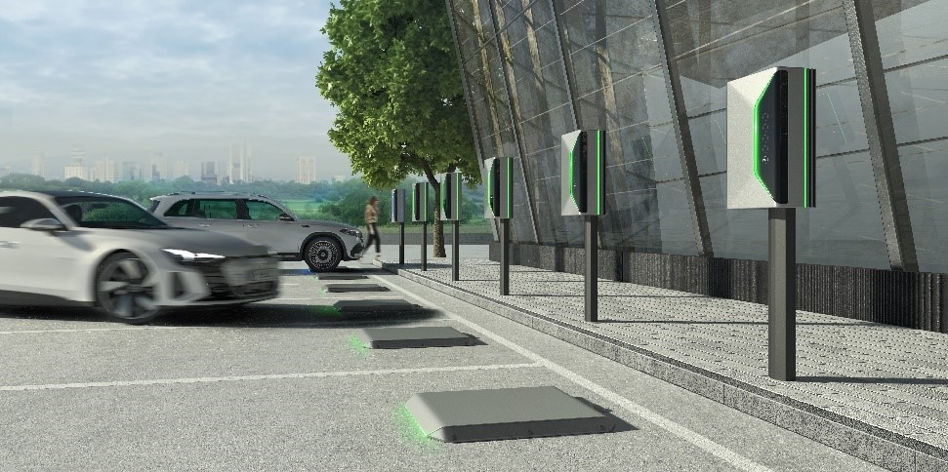
Thesis Project Proposal
AI-Enhanced Communication Link for Wireless Inductive Charging Systems

Slide 2



Wireless Charging trends

Slide 3
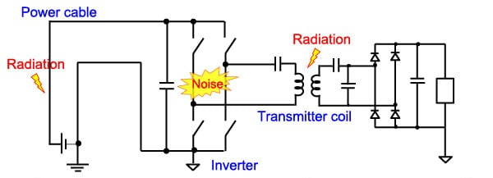
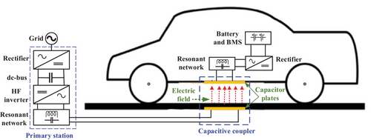
Project Motivation
Inductive charging systems suffer from strong EMI and noise
Reliable communication is difficult
Classical signal processing reaches performance limits
AI offers new adaptive and robust solutions

Slide 4
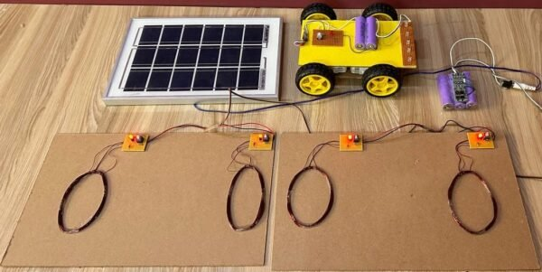
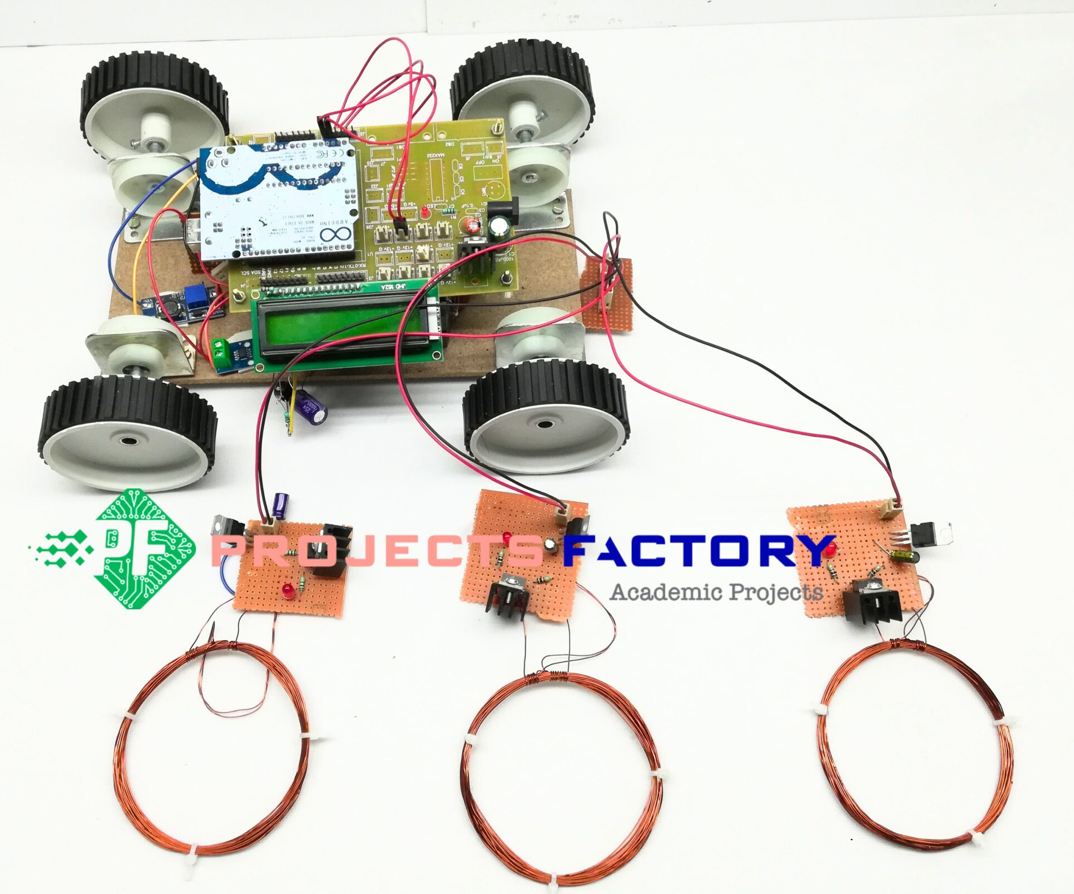
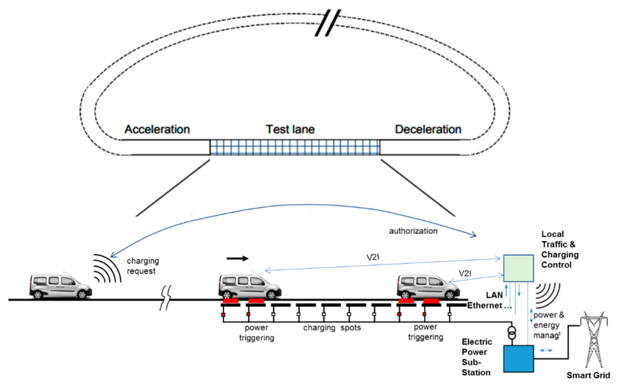
Project Objectives
Task | Duration
Literature review and research on wireless communication for inductive charging | 2 weeks
Design of wireless communication link (modulation, signal processing concepts) | 3 weeks
Development of power electronics interface (for the prototype hardware) | 3 weeks
Hardware prototype design and PCB implementation | 4 weeks
Implementation of AI-based demodulation algorithms | 3 weeks
Laboratory testing and validation of the system | 4 weeks
Data analysis, evaluation, and selection of best approach | 2 weeks
Thesis writing and documentation | 2 weeks
Ex:

Slide 5
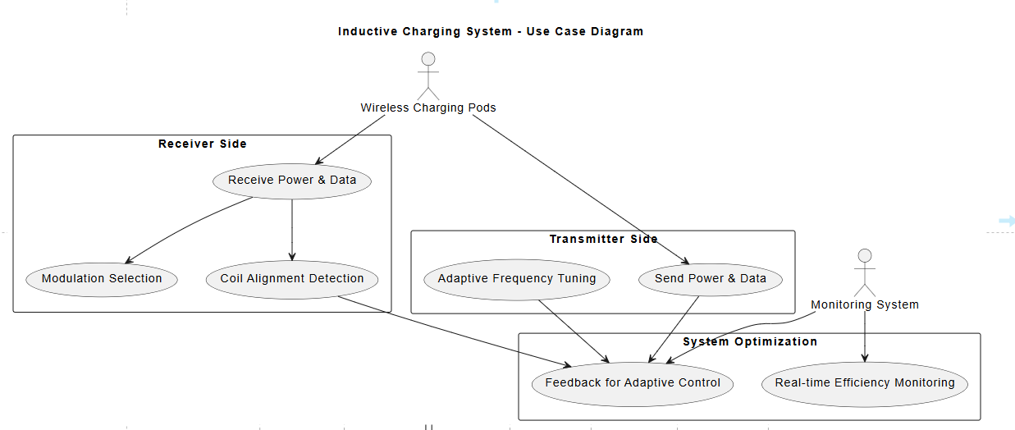
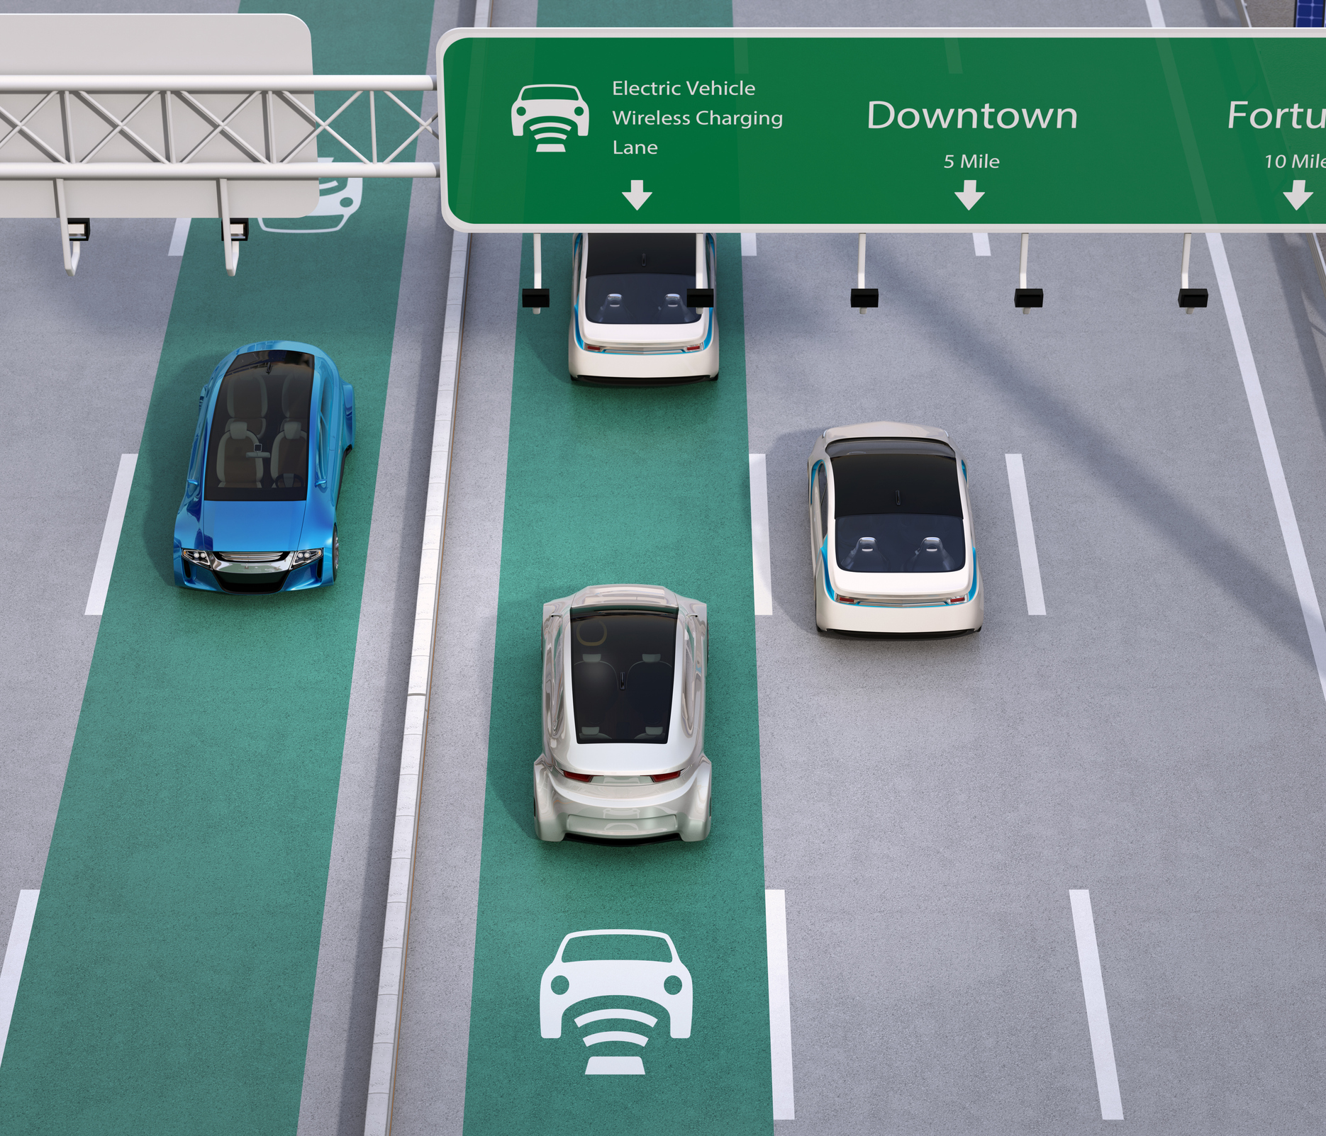
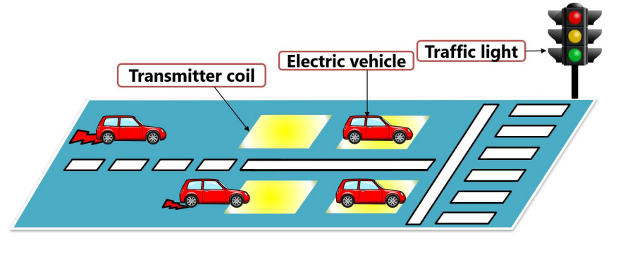
System Overview

Slide 6
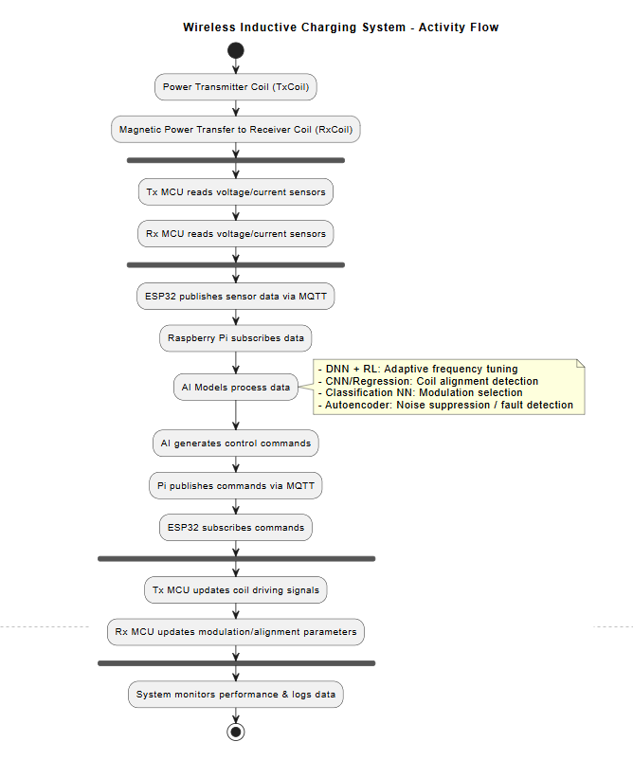
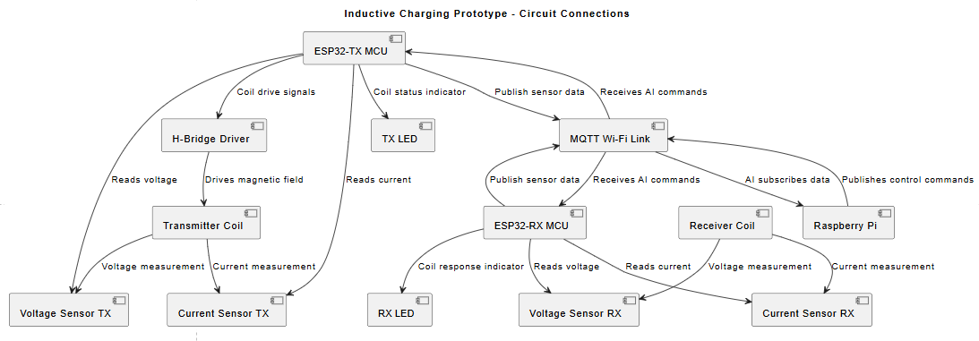

Slide 7
Hardware Architecture
Category | Component | Description | Quantity | Notes
Power / Coil | Transmitter Coil | Inductive charging coil, planar/circular | 1 | Choose frequency ~100–150 kHz
Power / Coil | Receiver Coil | Matching coil for RX | 1 | Same specs as transmitter coil
Power / Coil | H-Bridge / Coil Driver | MOSFET-based driver for Tx coil | 1 | Can use IRF540N or similar
Power / Coil | Capacitors | For LC resonant tuning | 4-6 | Ceramic / electrolytic, rated for coil voltage
Power / Coil | Inductors | Resonant matching | 2-4 | Depends on coil specs
Power / Coil | Shunt Resistors | For current sensing | 2 | Low ohm, high power
Power / Coil | Connectors & Wires | For connections | 1 set | 20–24 AWG recommended
MCU / Communication | ESP32 Dev Board | Wi-Fi + Bluetooth + basic TinyML | 1 | Preprocessing, sensors, communication
MCU / Communication | Level Shifters / ADC(Analog Degital Converter) | Optional if needed for voltage/current sensors | 1-2 | For interfacing analog signals
AI / Processing | Raspberry Pi 4 B | Runs ML and NNs | 1 | 8 GB
Sensors | Current Sensor Module | Measures coil current | 1 | ACS712 or similar
Misc / Prototyping | Breadboard / PCB | Prototype connections | 1 | For test circuits
Misc / Prototyping | Jumper Wires | Connections | 1 set | Male-to-male/female

Slide 8
AI Role
Automatic coil alignment detection (CNN + Regression Neural Network)
Adaptive frequency tuning (Deep Neural Network (DNN) + Reinforcement Learning (RL)
Dynamic impedance matching (Regression Neural Network (MLP))
Intelligent modulation selection (Classification Neural Network) for Noise also
Noise & interference suppression (Autoencoder)
Fault detection & protection (Autoencoder)
Efficiency optimization in real time (Deep Q-Network, DQN) system Stability & Power
I_tx | V_rx | Phase | Dist | Noise | Best Freq | Best Mod | Efficiency
2.1A | 35V | 21° | 8cm | low | 105kHz | FSK | 94%
1.7A | 29V | 45° | 15cm | high | 90kHz | PSK | 89%

Slide 9
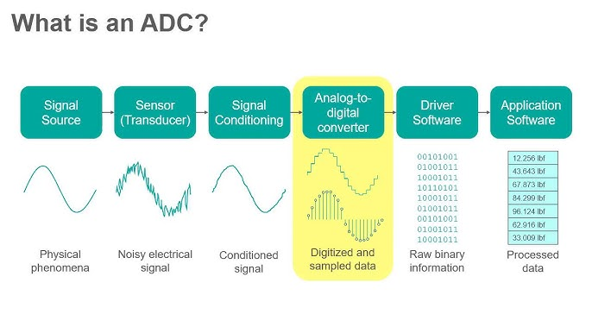

Dataset Collection
Real signal acquisition using ADC
Multiple distances, alignments, EMI testing levels
Automatic labeling via known TX bitstream

Slide 10
Prototype Development Plan
PCB design or Normal Breadboard
Firmware development
Hardware assembly
Lab testing

Slide 11
Experimental Validation
Bit Error Rate (BER) vs Distance
Bit Error Rate (BER) vs Noise
Evaluation Comparison: Classical vs AI demodulation

Slide 12
Project Timeline (6 Months)
Month 1: Research
Month 2: Simulation + Design
Month 3: Hardware design
Month 4: AI training
Month 5: Testing
Month 6: Final prototype + Thesis

Slide 13
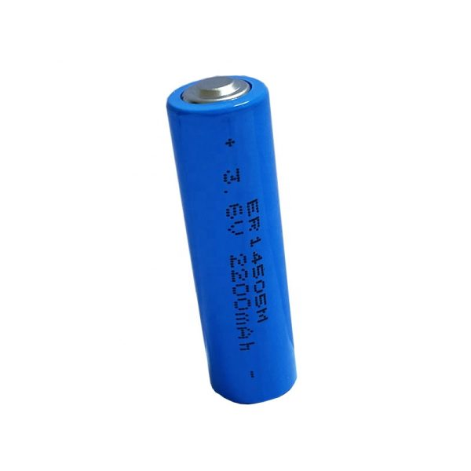
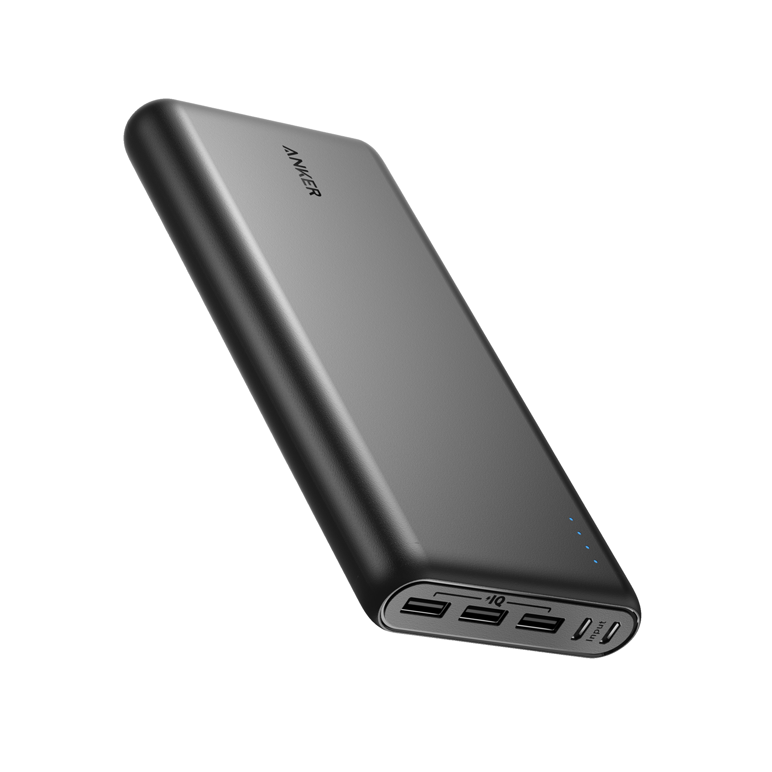
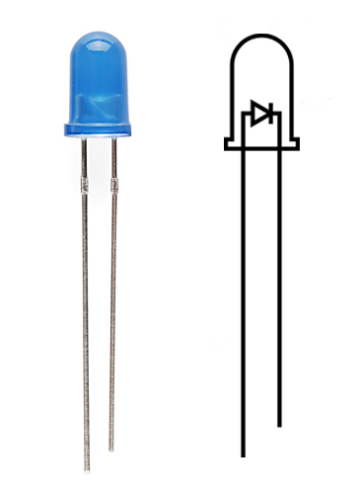
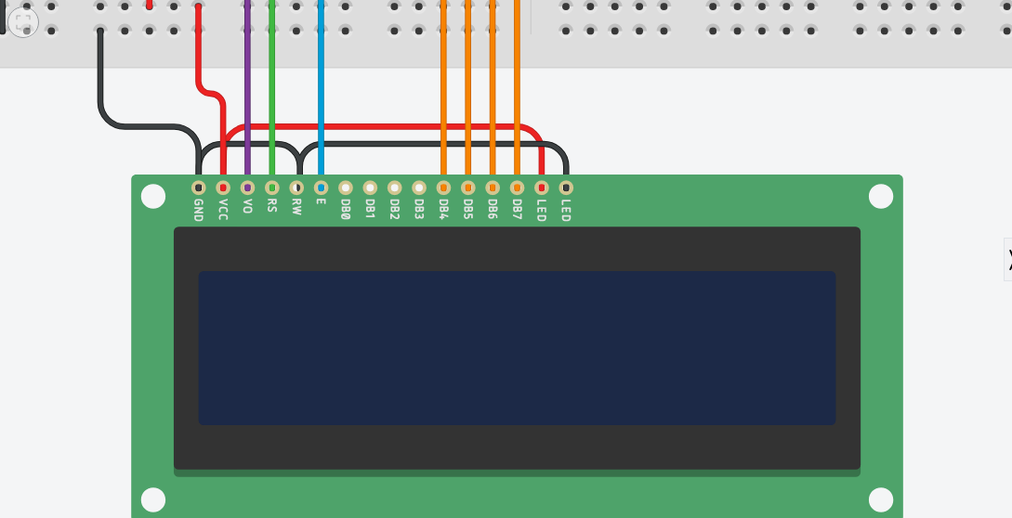
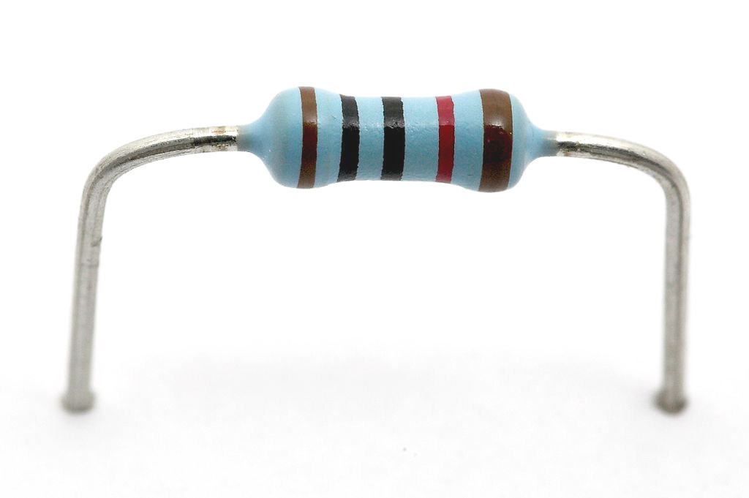
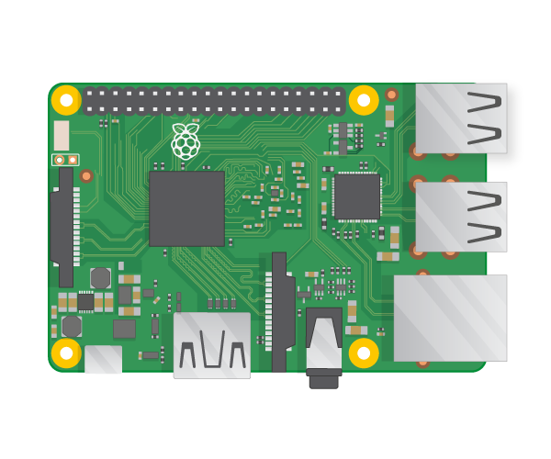
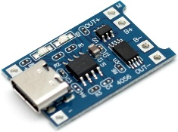

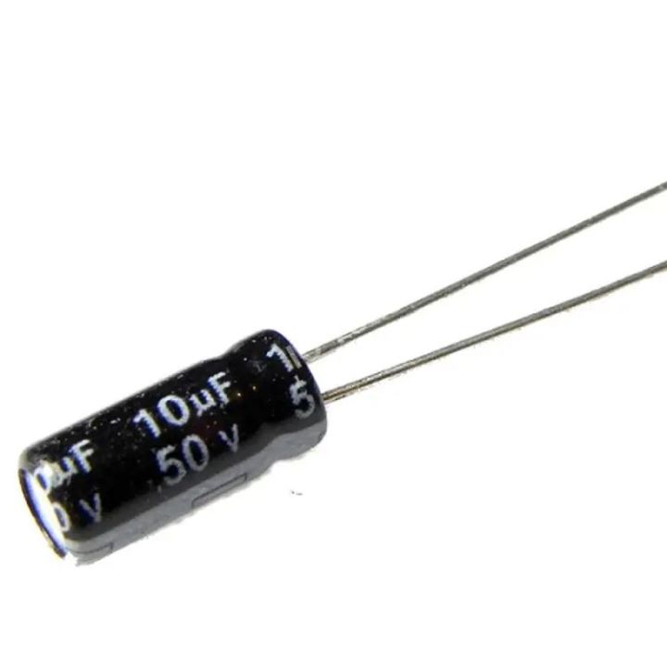
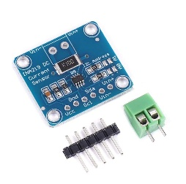
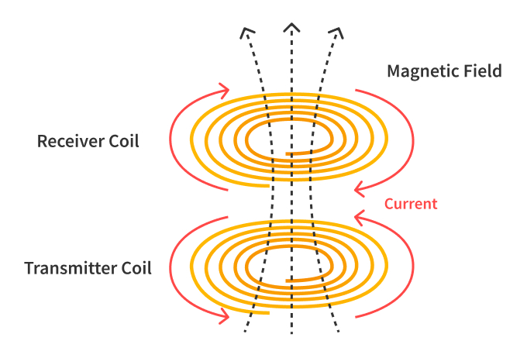
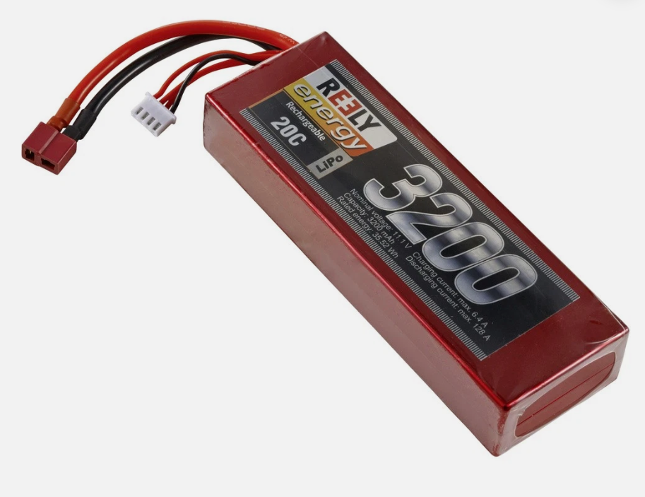
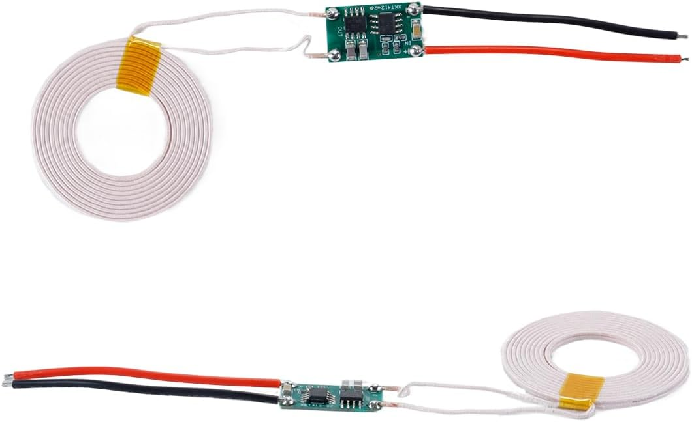

System Overview
Charge Battery 3.7V
Voltage/ Charging Display
LED & R
5V/3A power bank
TP4056 Safe Charge module
100uF & 0.1µF C
ML Digital
Data Model
Raspberry Pi4
INA219 I2C Digital Power Monitor
IN +
OUT
5V /2A
AC Wireless Charging
DC 11.1V
Transmitter
Receiver

